Slide 2
Housekeeping
Keep your microphone muted and camera off during presentations
Questions? Put them in the chat during presentations. Raise your hand or use your microphone during the discussion.
Note that these event presentations will be recorded, presentations will be published with authors’ permission
You’re welcome to tweet about this event: @dans_knaw_nwo
Please don’t take or publish any screenshots of the participants without asking their permission

Slide 3
Programme
15.30-15.40 Welcome and introduction DANS (Femmy Admiraal)
15.40-16.10 FAIR evaluation of the tools in life sciences (Ammar Ammar)
16.10-16.15 FAIR Aware introduction (Maaike Verburg & Linas Cepinskas)
16.15-16.30 Individual exploration of FAIR-Aware
16.30-16.55 Feedback / discussion (Maaike Verburg & Linas Cepinskas)
16.55-17.00 Wrap up (Femmy Admiraal)

Slide 4
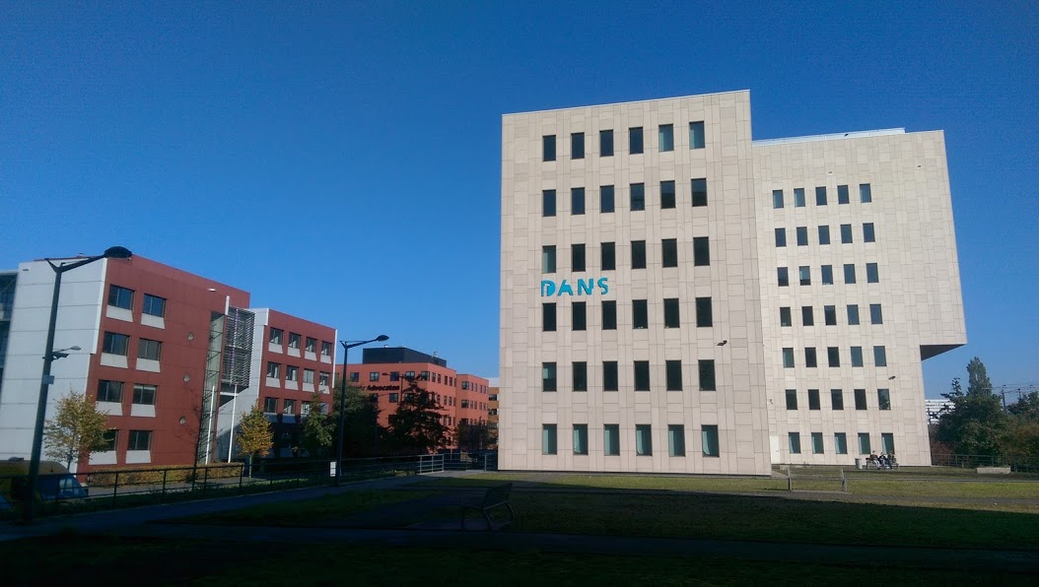
DANS organization 2005-2020
Mission: promote and provide permanent access to digital research resources
Institute of Dutch Academy and Research Funding Organisation (KNAW & NWO) since 2005

Slide 5
Focus on FAIR (2021-2025): three pillars
Centre of Expertise
Versatile repository
Active collaborator

Slide 6
National Centre of Expertise
Research Data Management experts
Focus on knowledge transfer to national level
Business intelligence unit

Slide 7
Versatile repository
Technological foundation: Dataverse
Four domain-specific Data Stations
Services: DataverseNL and Data Vault Station

Slide 8
Active collaborator
Main national service providers
Main domain specific service providers

Slide 9
Active collaborator

Slide 10
Thanks for listening
DataLink @DANS_knaw_nwo DANS_knaw_nwo E-data & Research info@dans.knaw.nl dans.knaw.nl

